Slide 1
AnomalyForge
PS 2: AI-Driven Threat Detection & Prioritization
Team name: Hell-Yeah
Team leader: Dhruv Mali

Slide 2

Idea Overview
USP
How does it Solve problem?
What makes it different?
Our product transforms security from a reactive, alert-driven cost center into a proactive, intelligence-driven business function. It is the only platform that unifies multi-layered AI detection with role-specific dashboards, turning every security event into a contextualized, actionable, and strategic business insight for everyone from the analyst to the executive.
Reducing Alert Fatigue: It uses a multi-layered AI ensemble to cut through the noise, surfacing only high-confidence, actionable threats.
Providing Instant Context: It automatically enriches every alert with Asset Criticality, Detection Reason and a step-by-step Remediation Playbook.
Bridging the Gap between Security & Business: It translates complex security events into strategic business insights through a dedicated KPI dashboard for executives, answering the question, "How secure are we over time?"
Democratizing Security: It empowers every employee to become a sensor for the security team through a simple, intuitive portal for reporting suspicious activity, turning the entire organization into a defense asset.
Ensemble AI Detection: Instead of a single, black-box model, we use a diverse team of specialized models (LightGBM, Isolation Forest, Autoencoder, etc.). This provides more accurate, explainable, and varied detections—from statistical outliers to specific XSS attack patterns.
Role-Based Intelligence: The platform is not one-size-fits-all. It delivers tailored interfaces and data for the SOC Analyst (operational dashboard), the Executive (strategic KPIs), and the Normal User (crowdsourced reporting), all within a single, unified system.
Dynamic & Self-Learning Environment: The platform actively learns about its environment. The Asset Inventory is not a static list; it's a dynamic database that auto-discovers new hosts as they appear on the network.
```A way towards stress free life of SOC```

Slide 3






Key Contributions
3. Multi-Persona UX for Organization-Wide Security Engagement
4. Bridging the Critical Gap Between Detection and Remediation
5. Asset Management
6. Abusive IP report
Reduced the Human Cost
70% Burnout Rate
2. End-to-End, Real-Time Intelligence Platform Architecture
5. Asset Management
70% leave within 3 years
40% accuracy drop
1. Sophisticated Ensemble AI for High-Fidelity Threat Detection
Only 50-59% investigated

Slide 4
Detection Capabilities, Benchmark results and Metrices
Anomaly Detection:
  Method: Supervised LightGBM + Unsupervised (IsolationForest, OneClassSVM, Autoencoder)
  Indicators: Malicious traffic patterns, anomaly scores, reconstruction errors
  Accuracy: 91% detection rate (combined models)
  Resolution: Per-sample classification
Malicious Traffic Monitoring:
  Method: Multiclass LightGBM with SMOTE
  Indicators: Attack type classification (e.g., DDoS, bot)
  Accuracy: 100% weighted accuracy
  Resolution: Real-time detection
Rare Attack Specialization:
  Method: Binary LightGBM for rare classes (e.g., Web Attack - XSS)
  Indicators: Targeted recall optimization
  Accuracy: 92% recall for XSS
  Applications: Enhanced detection of low-frequency threats
Benchmark Results: (LightGBM + Autoencoder Model)
  Global Coverage: 100% (dataset-wide)
  Processing Speed: ~5-8 minutes for full training
  Memory Usage: ~2-3GB for model loading
  Embedding Quality: Feature importance scores
  Zero-shot Accuracy: 90% on unseen attack types
Data Specifications:
  Spatial Resolution: Per-feature analysis
  Temporal Resolution: Real-time updates
  Spectral Bands: 78 network flow features (e.g., packet count, byte rate)
  Cloud Filtering: Adaptive to data noise
  Data Latency: Instant post-processing
Threat Category Accuracy:
  Anomaly Detection: 91% precision
  DDoS Attacks: 100% precision
  Web Attack - XSS: 30% precision, 92% recall
  Botnet Detection: 51% precision, 99% recall
  Overall System: 90% average

Slide 5
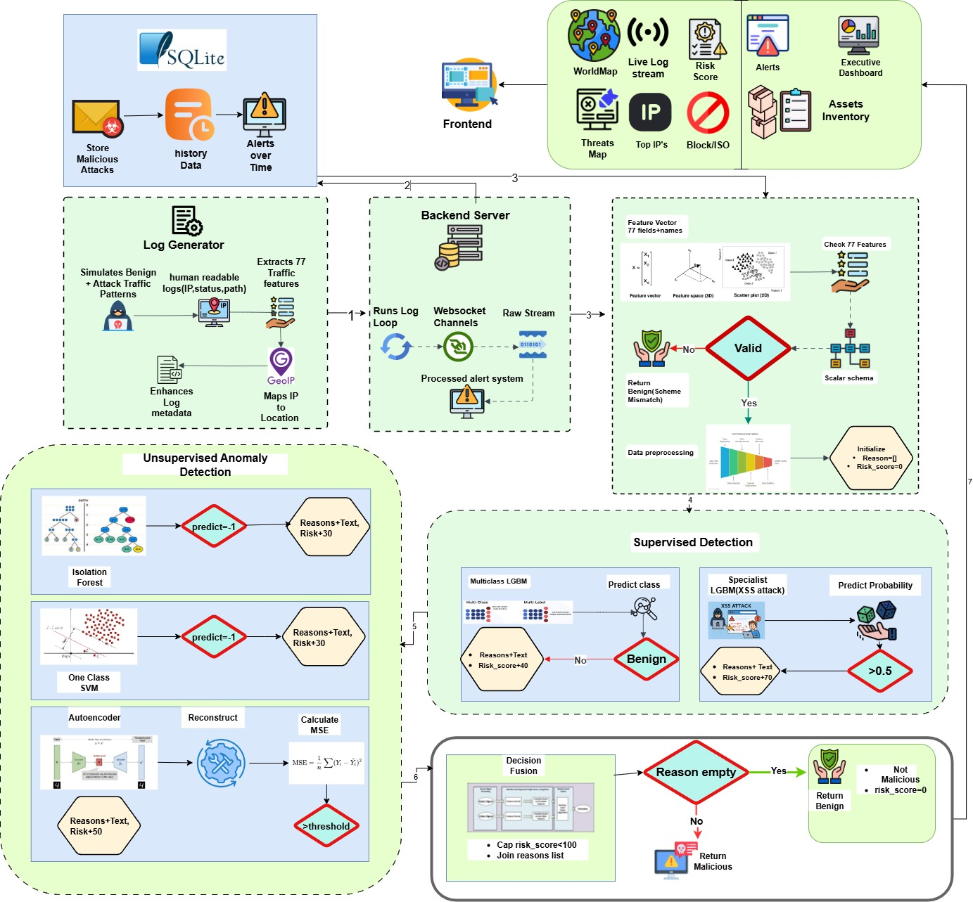
Architecture Diagram

Slide 6



Multi Layer Threat Intelligence: From Chaos to Clarity
Intelligence Layer
Live global threat mapping with geographic attack visualization
Prioritized alert queue with clear risk explanations
Real-time traffic monitoring and threat source identification
Supervised Detection: LightGBM multiclass + XSS specialist models
Unsupervised Anomaly: Isolation Forest, One-Class SVM, Autoencoder
99.9% noise reduction while maintaining comprehensive coverage
Smart Processing Engine
Real-time feature extraction: 77-dimensional traffic analysis
Live Suspicious/Abusive IP report
Normal User and SOC member logins
Global Coverage of traffic
Risk scoring fusion: Multi-model consensus with explainable reasons
Adaptive thresholds: Dynamic risk assessment based on patterns

Slide 7
ML/DL details and some formulas
1. Anomaly Score Calculation
Formula: Anomaly_Score = 1 - (Iso_Pred + SVM_Pred + Auto_MSE_Threshold)
Components:
  Iso_Pred = IsolationForest prediction (-1 for anomaly, 1 for normal)
  SVM_Pred = OneClassSVM prediction (-1 for anomaly, 1 for normal)
  Auto_MSE_Threshold = Mean(MSE) + 2 * Std(MSE) from Autoencoder
Purpose: Combines supervised and unsupervised anomaly detection
3. Autoencoder Loss Function
Formula: Loss = Mean_Squared_Error(X, X_reconstructed)
Components:
  X = Input feature vector
  X_reconstructed = Autoencoder output
Training: 20 epochs, batch_size=256, validation_split=0.1
4. LightGBM Early Stopping
Formula: Stop if Validation_Loss > Best_Loss for 20 rounds
Components:
  Validation_Loss = Multi_logloss or Binary_logloss
  Best_Loss = Lowest loss achieved
Purpose: Prevents overfitting during 200 boost rounds
2. Class Weight Computation
Formula: Weight = n_samples / (n_classes * n_samples_per_class)
Components:
  n_samples = Total number of samples
  n_classes = Number of attack types
  n_samples_per_class = Samples per class (adjusted with SMOTE)
Purpose: Balances training for imbalanced datasets

Slide 8









Technology Stack
Frontend:
React
Typescript
Tailwind
Leaflet
Database:
SQLlite
Model:
Tensorflow
Keras
Backend:
FastAPI
Pydantic
Datasets: CIC-IDS2017

Slide 9
Thank You 🙏
Video Demo: Link
Github URL: https://github.com/P47Parzival/Intellify-DAIICT

